Slide 1
SSK-DNN: Semantic and Sentiment Knowledge for Incremental Text Sentiment Classification
IncrLearn Workshop
Incremental Classification and Clustering, Concept Drift, Novelty Detection, Active Learning in Big/Fast data Context
In Conjunction with
23rd IEEE International Conference on Data Mining – ICDM 2023
Dec. 1-4, 2023, Shangai, China
KYUNG HEE
UNIVERSITY
SSK-DNN: Semantic and Sentiment Knowledge for Incremental Text Sentiment Classification
Jawad Khan, Niaz Ahmad, Chanyeok Choi, Saif Ullah, Gyurin Kim and Youngmoon Lee
Real-Time AI and Systems Engineering Lab
Department of Applied AI
Hanyang University, South Korea

Slide 2
PRESENTATION AGENDA
INTRODUCTION
Background
Motivation
Problem Statement
PROPOSED SOLUTION
Semantic & Sentiment Knowledge Aware Incremental Deep Neural Network
EXPERIMENTS & RESULTS
Dataset
Experimental Setup
Results & Discussion
CONCLUSION

Slide 3
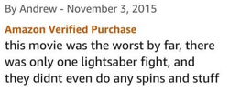
Introduction
Sentiment analysis (SA) / Opinion Mining
extracts and analyzes people’s opinions, and emotions
regarding topics, products, individuals, organizations, and services
classify the unstructured textual data into positive and negative classes
Text mining, and AI techniques, including machine learning and deep learning are used for SA automation

Slide 4
Introduction ---Text Classification
Quality training data preparation
Effectively utilize the hidden significant information in the unstructured data
Model is built right
Accurate prediction/right decision making

Slide 5
Motivation
TEXTUAL BIG-DATA
END USER
Read Text Manually
Online Reviews benefits
USER REVIEWS (SOCIAL NETWORK SITES)
CONSUMER ONLINE OPINION BUILDING
IMPROVING PRODUCT QUALITY
OPINIONS EXPRESSED BY USERS
DEMAND FURTHER INVESTIGATION
Machine
Derive
Automation Techniques
Useful Insights
Derive
User Feedback Analysis Process:
Qualitative data in the form user reviews are available online
Reviews are selected for analysis
Important aspects are derived for product design decision

Slide 6
Problem and Solution

Slide 7
Semantic & Sentiment Knowledge aware Deep Neural Network
1
2
3
4
5
6
Incremental Learning
Main insights
Initial training on an initial dataset without without retraining on the entire dataset
1. Identify/extract sentiment features from unstructured noisy-user generated text.
2. Dynamic word embedding and real-value dense vector representation
3. Dimensionality reduction employing PCA statistical feature reduction algorithms
4. To capture word dependency and sequential patterns in the data.
5. To pick and represent the salient sentiment features
6. Predicting outcomes like positive or negative sentiment

Slide 8
Text Pre-processing
1
Incremental Learning
Main insights
1. Identify/extract sentiment features from unstructured noisy-user generated text.

Slide 9
Lexicon Standardization and Integration (WCSL)
Lexical Resources (Sentiment Lexicon) | Category | Sentiment Score | Revised Sentiment Score
AFFIN | N/A | [-5, +5] | [-1, +1]
GI | Positive, Negative, pstv, ngtv, strong, weak etc. | N/A | [-1, +1]
OL | Positive, Negative | N/A | [-1, +1]
SentiWordNet | Positive, Negative, Objective | [0,1] | [-1,+1, 0]
SO-CAL | N/A | [-5, +5] | [-1,+1,0]
Subjectivity Lexicons | Positive, Negative, Neutral | N/A | [-1,+1,0]
WordNet - Affect | Positive, Negative, Ambiguous, Neutral | N/A | [-1,+1,0]
NRC Hashtag Sentiment lexicon | Positive, Negative | [-7, +7] | [-1, +1]
SenticNet5 | Positive, Negative | [-1, +1] | [-1, +1]
SentiSense | Like, Love, Hope, Hate etc. | N/A | [-1,+1]
Incremental Learning
Example
Word | LR1 (Score) | LR2 (Score) | LR3 (Score) | LR4 (Score)
Easy | +1 | +1 | +1 | -1
Average Score | (+1)+ (+1)+(+1)+(-1)/4 =2/4= 0.5 > 0 [Positive] => If Polarity Score < 0 [Negative], If Polarity Score =0 [Neutral]

Slide 10
Linguistic Semantic Rules
Linguistic Semantic Rules
1
Incremental Learning
Rule | Example | Linguistic Semantic Rules
R1 | I have never like that director, but I love this movie. | If a sentence contains “but”, ignore previous sentiment and only consider the sentiment after “but” part.
R2 | I love this movie, despite the fact that I hate the director. | If a sentence contains “despite”, only consider the sentiment before the “despite” part.
R3 | Everyone like this video unless he is a sociopath | If sentence contains” unless” and the “unless” is followed by a negative clause, ignore the “unless” clause.
R4 | While they did their best, the team played a horrible game. | If a sentence contains “while” ignore the sentence following the “while” and consider the sentiment only of the sentence that follows the one after the “while”.

Slide 11
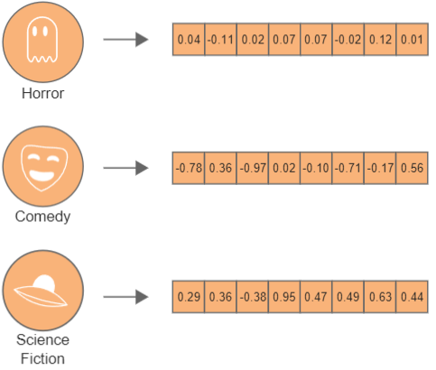
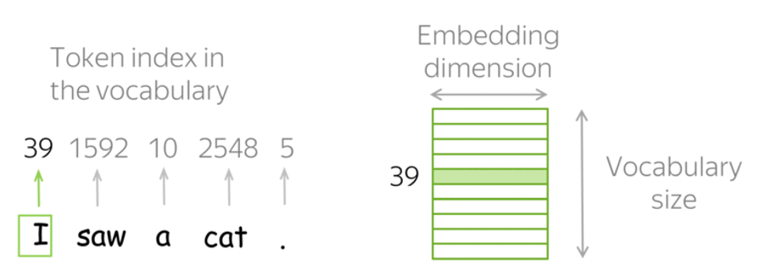
Sentiment-Enhanced Embedding
2
Incremental Learning

Slide 12
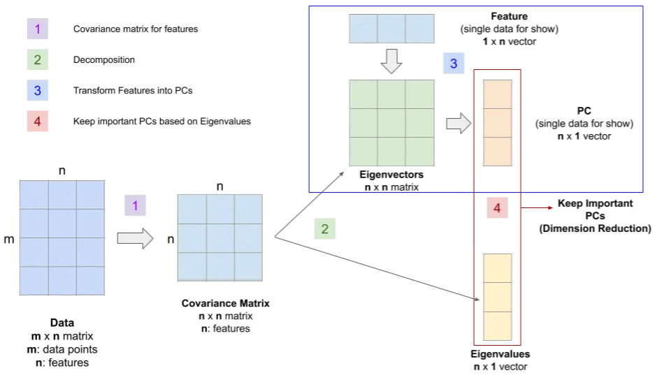
Dimensionality Reduction (PCA)
Incremental Learning
3
Main insights
We utilize PCA to effectively reduce the dimensionality of the feature set
PCA is favored for its speed, intuitive nature, and remarkable ability to retain the original information to a significant extent

Slide 13
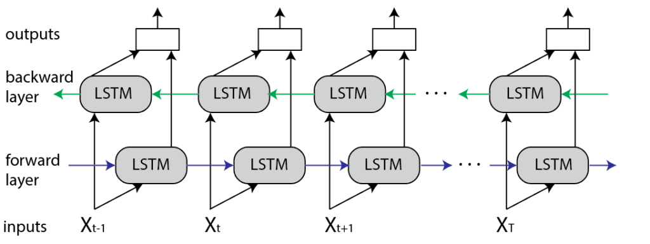
BiLSTM Architecture
4
Incremental Learning
Main insights
To explore the deeper internal relationship within the data
BiLSTM is ideal for sentiment analysis as it captures word dependencies and context in sentences effectively

Slide 14
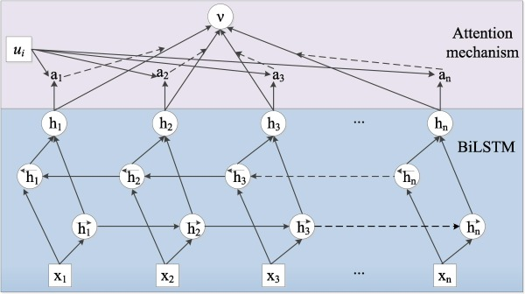
Attention Mechanism
5
Incremental Learning
Main insights
To assigns different weights or scores to each word in the sentence based on their importance
To highlights the most relevant input features during prediction
Notes:
.

Slide 15
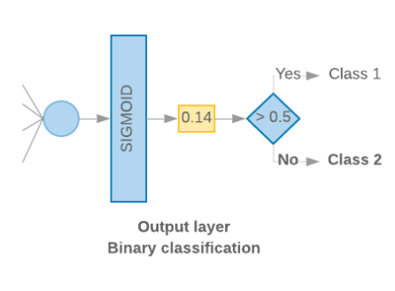
Attention Mechanism
5
Incremental Learning
Main insights
The sigmoid function is ideal for binary sentiment classification, predicting outcomes like positive or negative sentiment.
The network's sigmoid output, with a common threshold of 0.5, dictates binary sentiment classification: positive if above, negative if below.

Slide 16
Experiments
Experimental Setup
Dataset | Train | Dev | Test
MR | 8600 | 1000 | 1000
SST-2 | 1200 | 400 | 400
CR | 3000 | 400 | 400
SemEval | 9684 | 1654 | 3813
Datasets
Movie Reviews (MR), Stanford Sentiment Tree Bank (SST-2), Customer Reviews of 5 products (CR), and SemEval 2014
Tools and Library
Rapidminer Studio and Python NLTK Tensor flow
Environment
Ubuntu 16.04, Core i5 PC (32 GB Memory)
Evaluation metric
Accuracy = correctly classified reviews / total number of reviews
Hyperparameter | Value
Word vector dimension | 300
BiLSTM Layer | 128
Dropout rate | 0.5
l2 constraint (s) | 3
Epochs | 10
Batch Size | 128
paired t-test | (P<0.05)

Slide 17
Ablation Results
SSK-DNN: SSK+BERT+PCA+BiLSTM+Attention
Proposed model (SSK-DNN (SSK+BERT+PCA+BiLSTM+Attention) improvement for three benchmark dataset

Slide 18
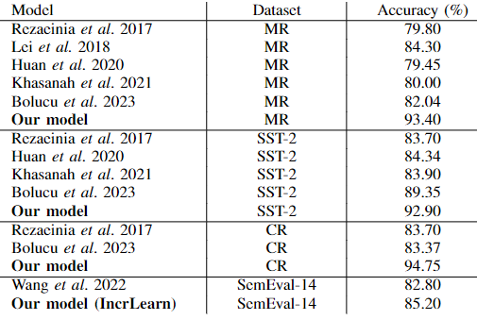
Comparative Study
Main reasons of performance improvement
Intelligent text pre-processing: Noisy and irrelevant features are removed
Sentiment knowledge and linguistic rules: Extracting and selecting relevant sentiment features employing
Sentiment-enhanced embedding: The dense representation of sentiment features in a real valued vector

Slide 19
Conclusion
An efficient incremental learning
Integrating the traditional FS method with the DL method
Sentiment knowledge and linguistic rules
Sentiment-enhanced word embedding
Popular pre-trained embedding models
BERT Convert words into real-valued, low-dimensional vectors representation
Statistical filter-based algorithms
Employing PCA statistical algorithm for dimensionality reduction, preserving critical information
BiLSTM with Attention Mechanism
Word dependency and give distinct sentiment weights to distinct words and pick salient sentiment words
Evaluation
Improved SA performance on four benchmark different domain datasets

Slide 20
Thank you for your attention

